Slide 1
Design and Construction of Static and Dynamic Calibration Cells
James Haner and Kyle Bearden
Dr. Stuart A. Craig
April 13, 2019

Slide 2
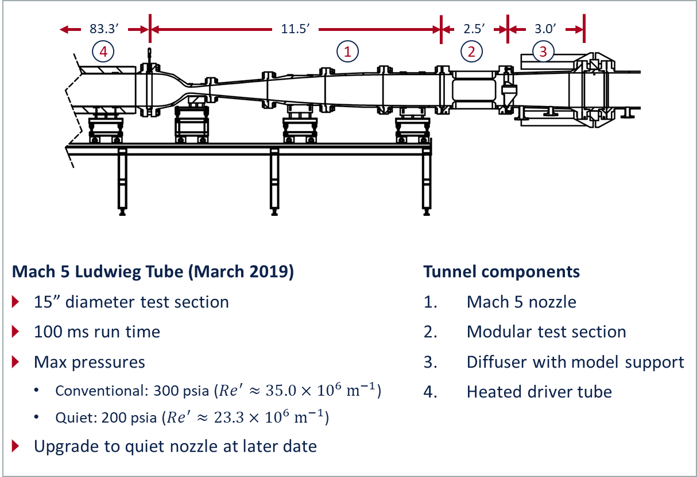
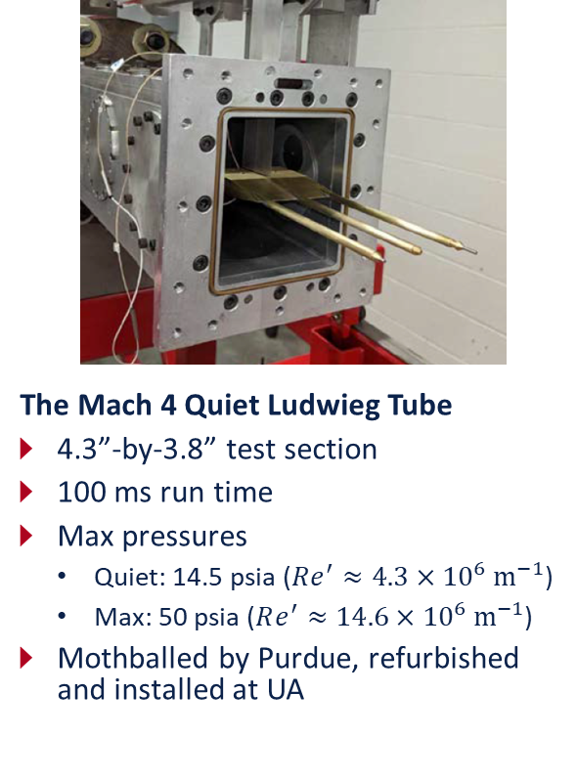
Boundary Layer Stability and Transition (BLST) Laboratory

Slide 3
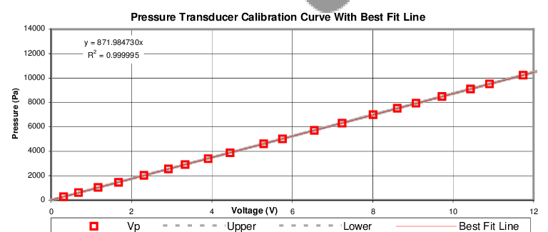
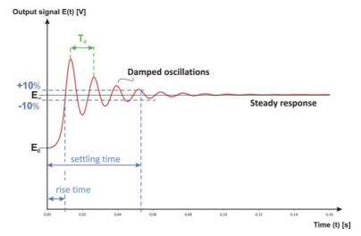
Motivation
Static Cell:
  Be able to calibrate pressure transducers in-house (to full range of conditions 0 – 300 psi)
  Reduced turn-around time and cost of re-calibration
  Ability to verify manufacturer calibration data
Dynamic Cell:
  Determine resonance, damping, and frequency response of pressure transducers
  Ability to calculate/account for how the sensor signal will change in response to step function
  Allows for better data processing through output filtering
  Precision down to 10 Hz
Calibration Curve of Pressure Transducer
Output signal of transducer due to step function

Slide 4
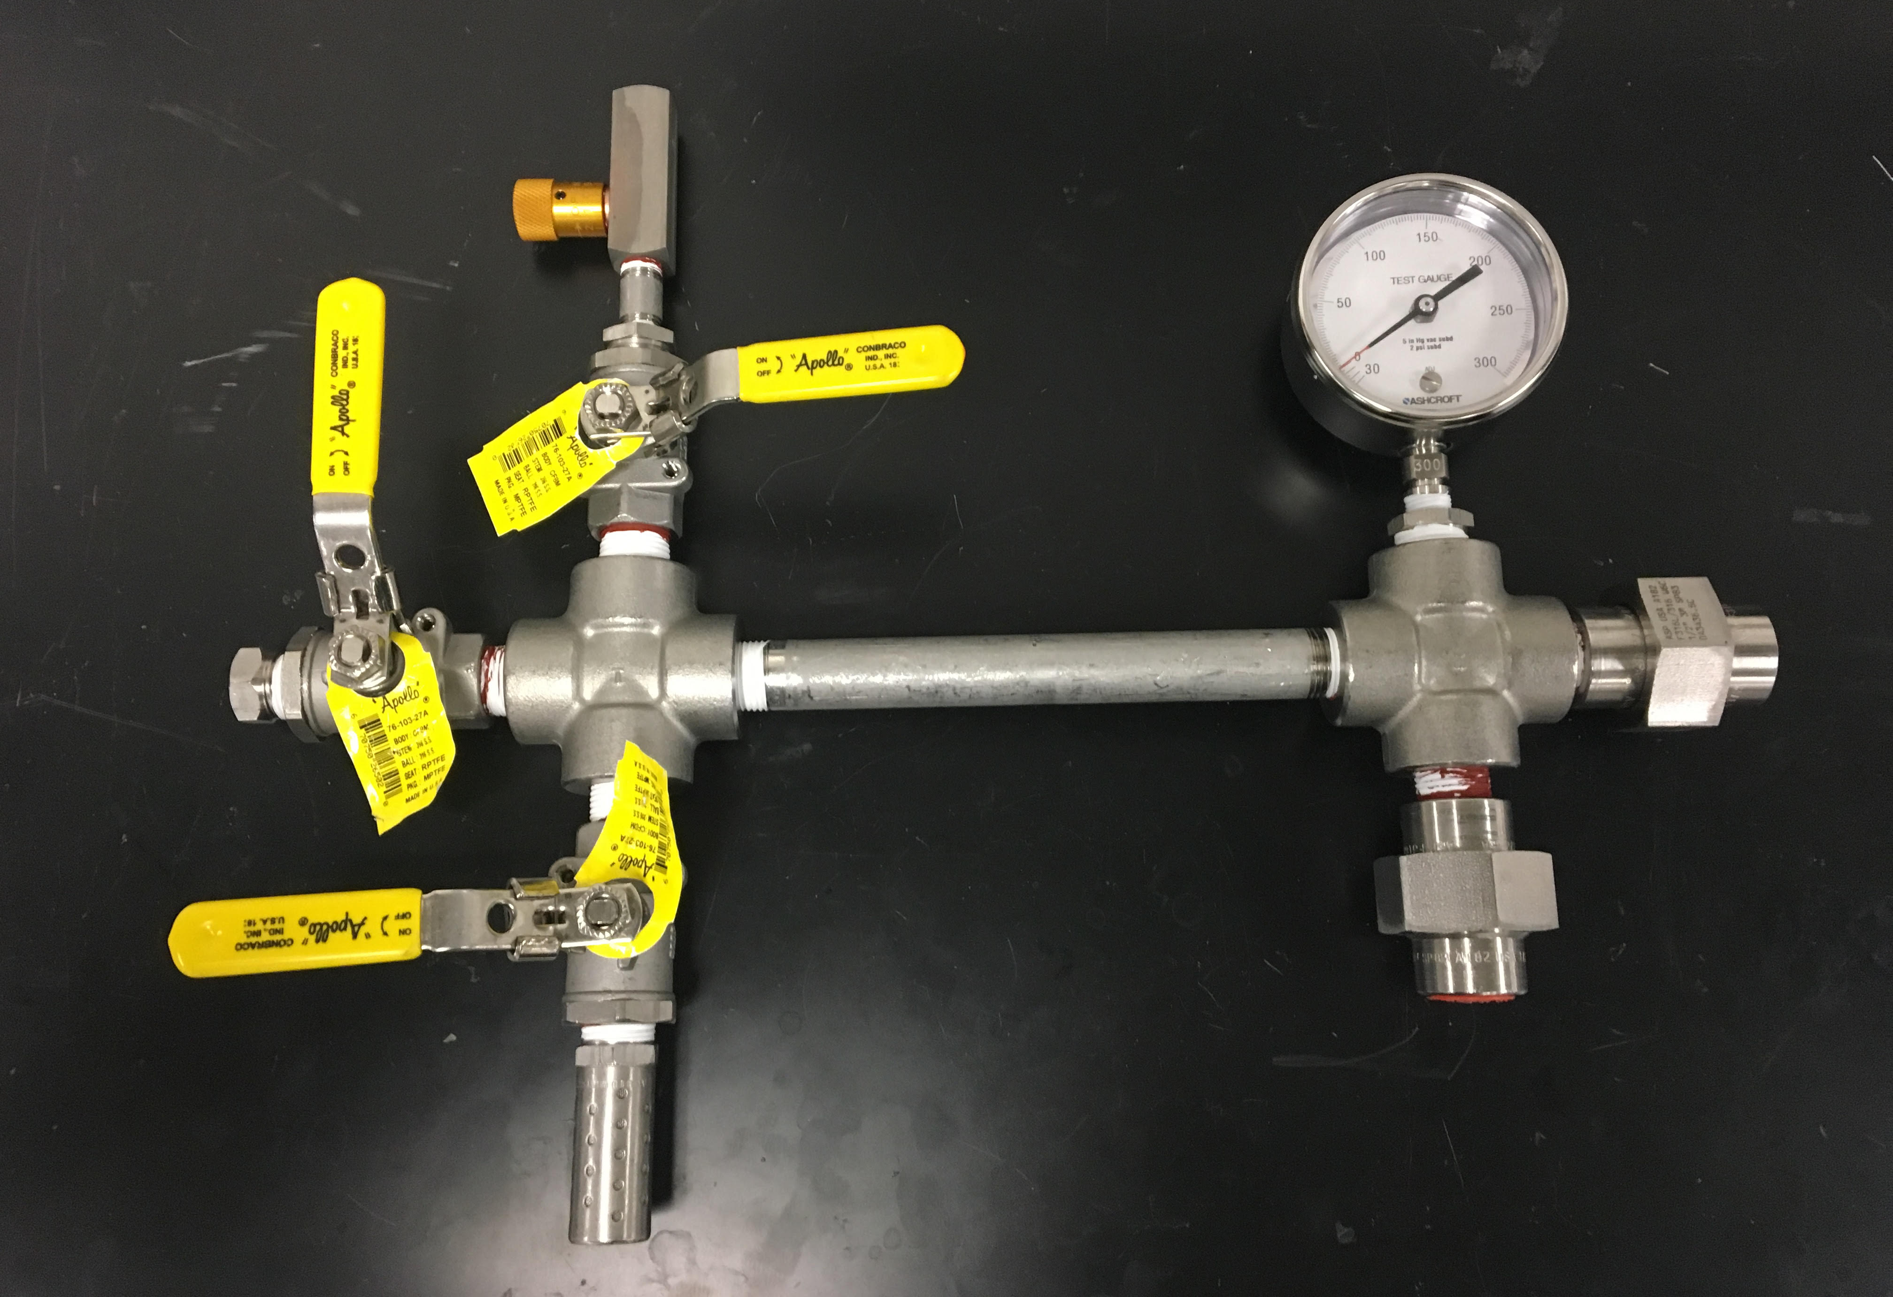
Static Cell Design
Components:
  Flow in (Pressure input)
  Flow Out(Pressure output)
  Vent
  Analog Gauge
  Baratron Port
  Kulite Mount
Allows for calibration from 0 – 300 psi
Union connection to Kulite Mount allows for rapid connecting/testing
Static Calibration Cell

Slide 5
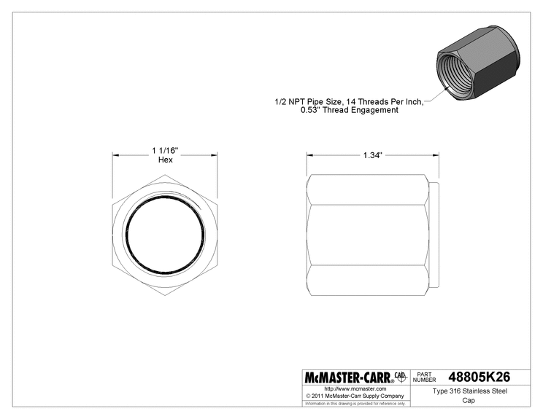
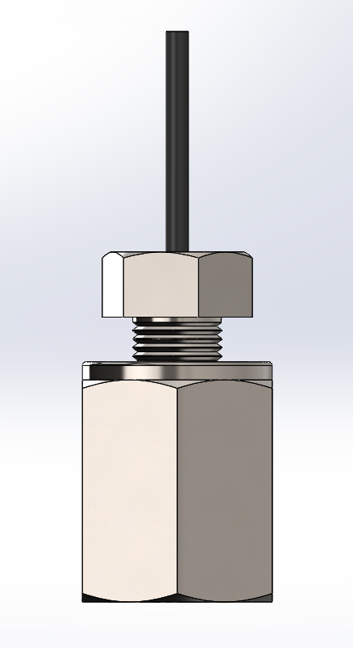
Kulite Mount
Holds onto Kulite without damaging probe
Uses pressure from compressed O-ring to hold Kulite tip in cap
Spacer between bolt and O-ring prevents interference and possible binding of bolt on O-ring
Pressure Cap
Kulite Mount

Slide 6
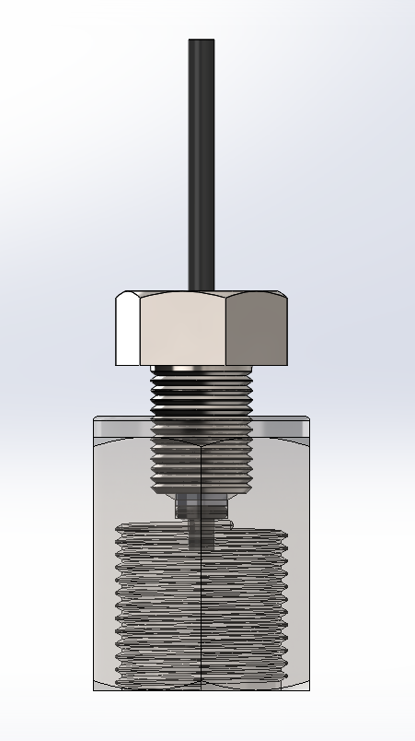
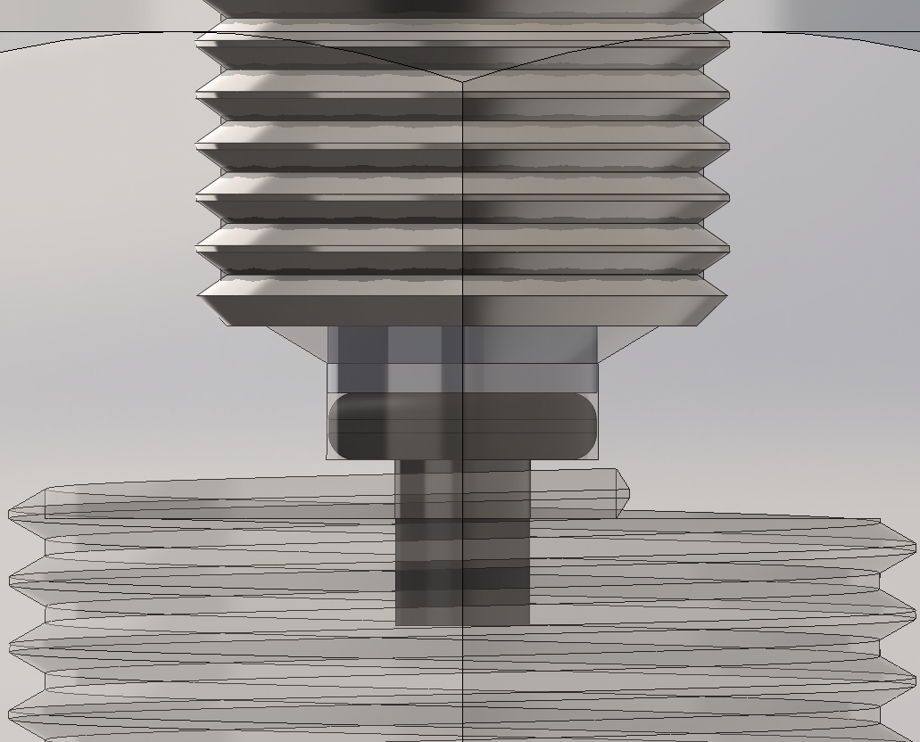
Kulite Mount Cont.
Kulite Mount (Transparent)
Sealing Mechanism of Kulite Mount

Slide 7
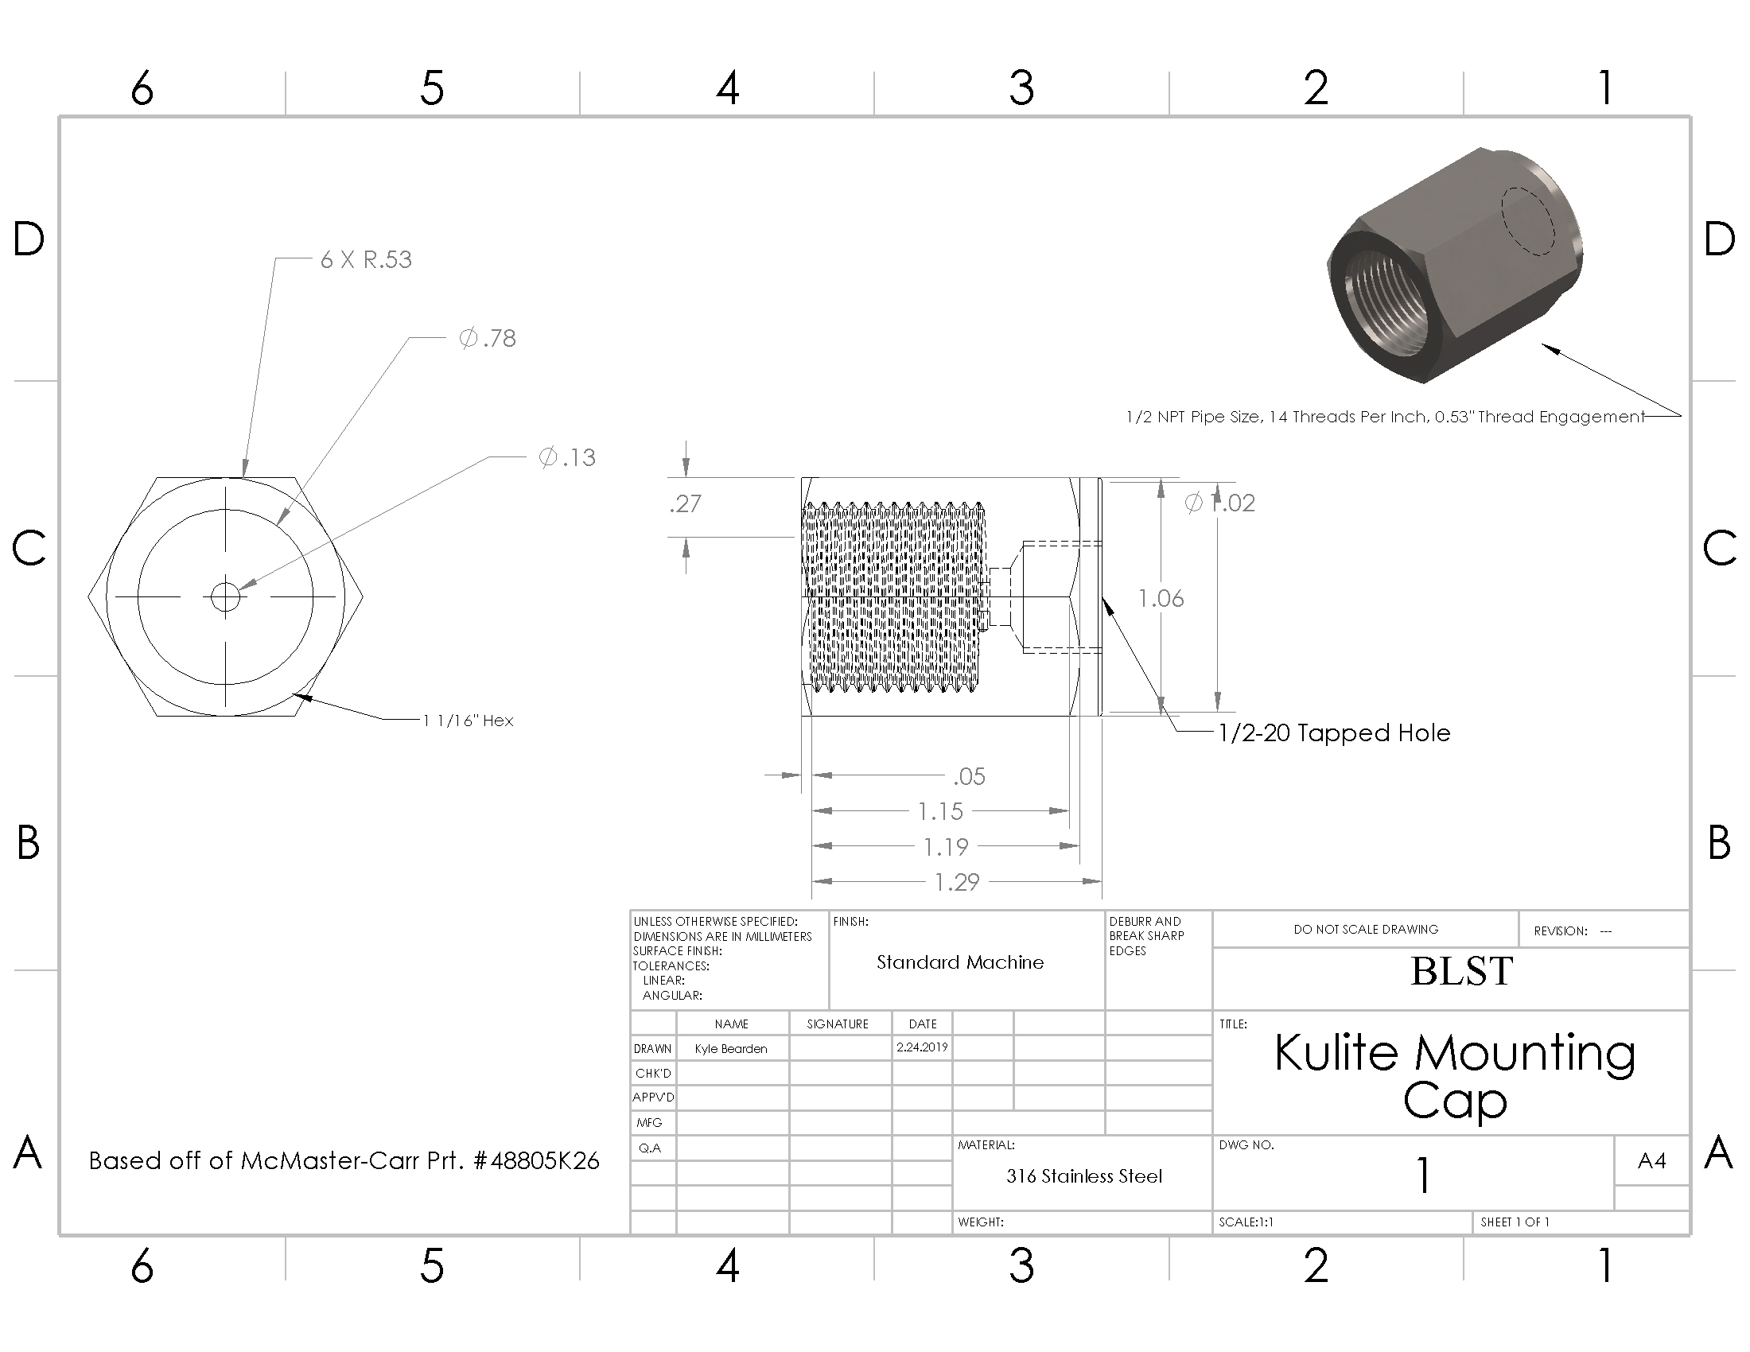
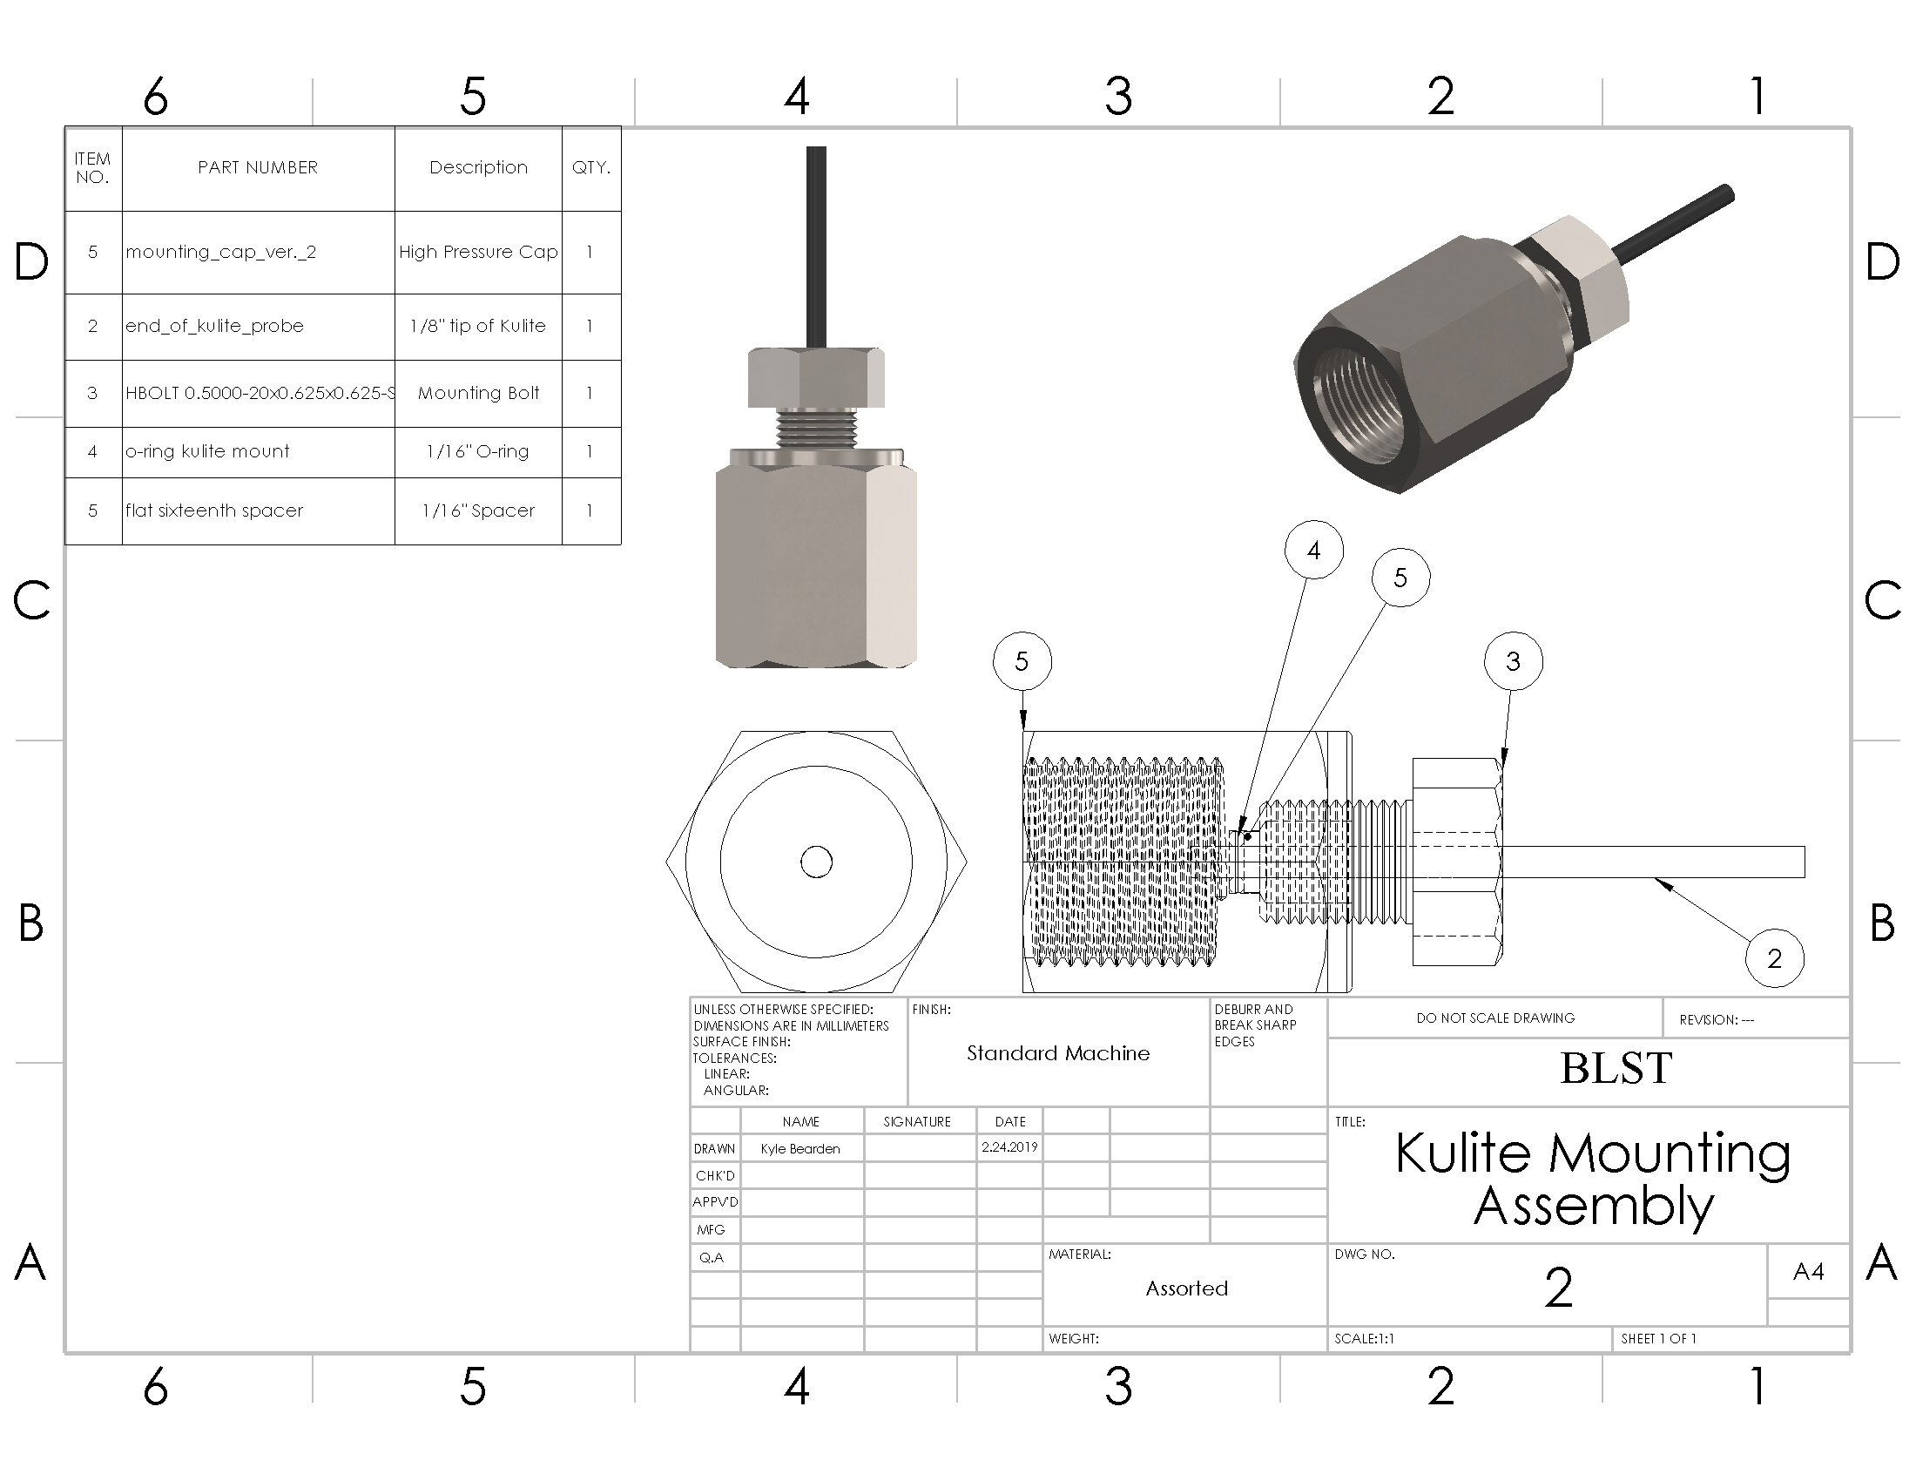
Kulite Mount Cont.
Kulite Mounting Cap – Drawing
Kulite Mounting Assembly

Slide 8
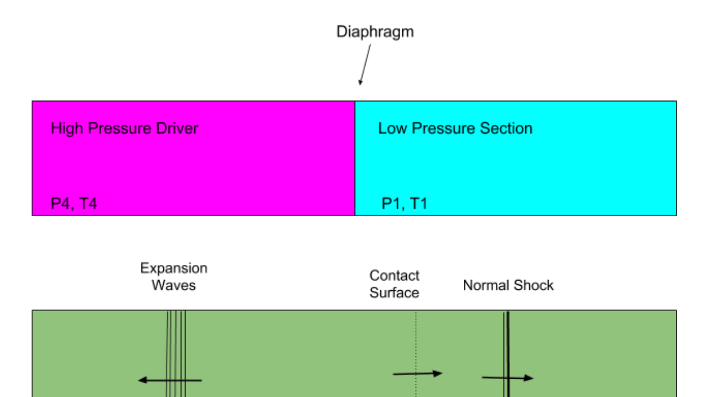
Purpose of Dynamic Cell
Create a shock to impact a Kulite mounted at the end of a shock tube
  By mounting the transducer on the end-cap of the shock tube, a clean, step function will be created
  Output signal of Kulite will be able to determine the rise time, settling time, natural frequency, and overall frequency response of the transducer
Shock Tube replicates shock conditions (scaled) on the Kulites experienced in the full-size tunnels
Information about frequency response can be applied to output filtering and the signal conditioners to have cleaner data collection

Slide 9
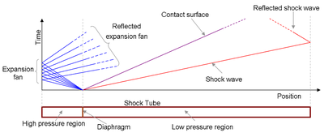
Design Considerations for the Dynamic Cell
Ideal design will allow 100 ms time delay between shock impact on transducer and the interference of expansion waves (being reflected back into transducer from wall).
  Utilize X-t diagrams: illustrate at which point interference occurs.
Shock wave needs to have sufficient time to normalize (become perpendicular to tube wall).
  Shock needs to be able to collapse upon itself to have linearity.
  Shock must move 20-times the pipe diameter (120 inches) to fully normalize prior to impacting Kulite.
Diaphragm should burst beginning at center to have uniform shock formation/consistent starting of tube
  Use thin mylar sheets for diaphragm

Slide 10
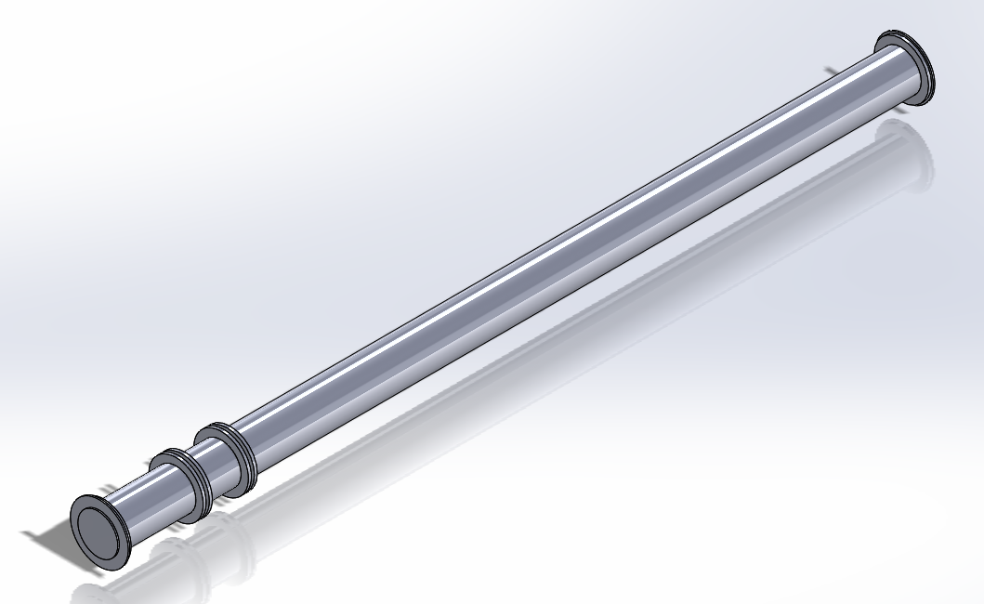
Dynamic Cell Design
Kulite mounted in back-wall of the shock-tube (to have as close to perfect of a step function being measured)
Pipe diameter = 6 inches
Double-diaphragm

Slide 11
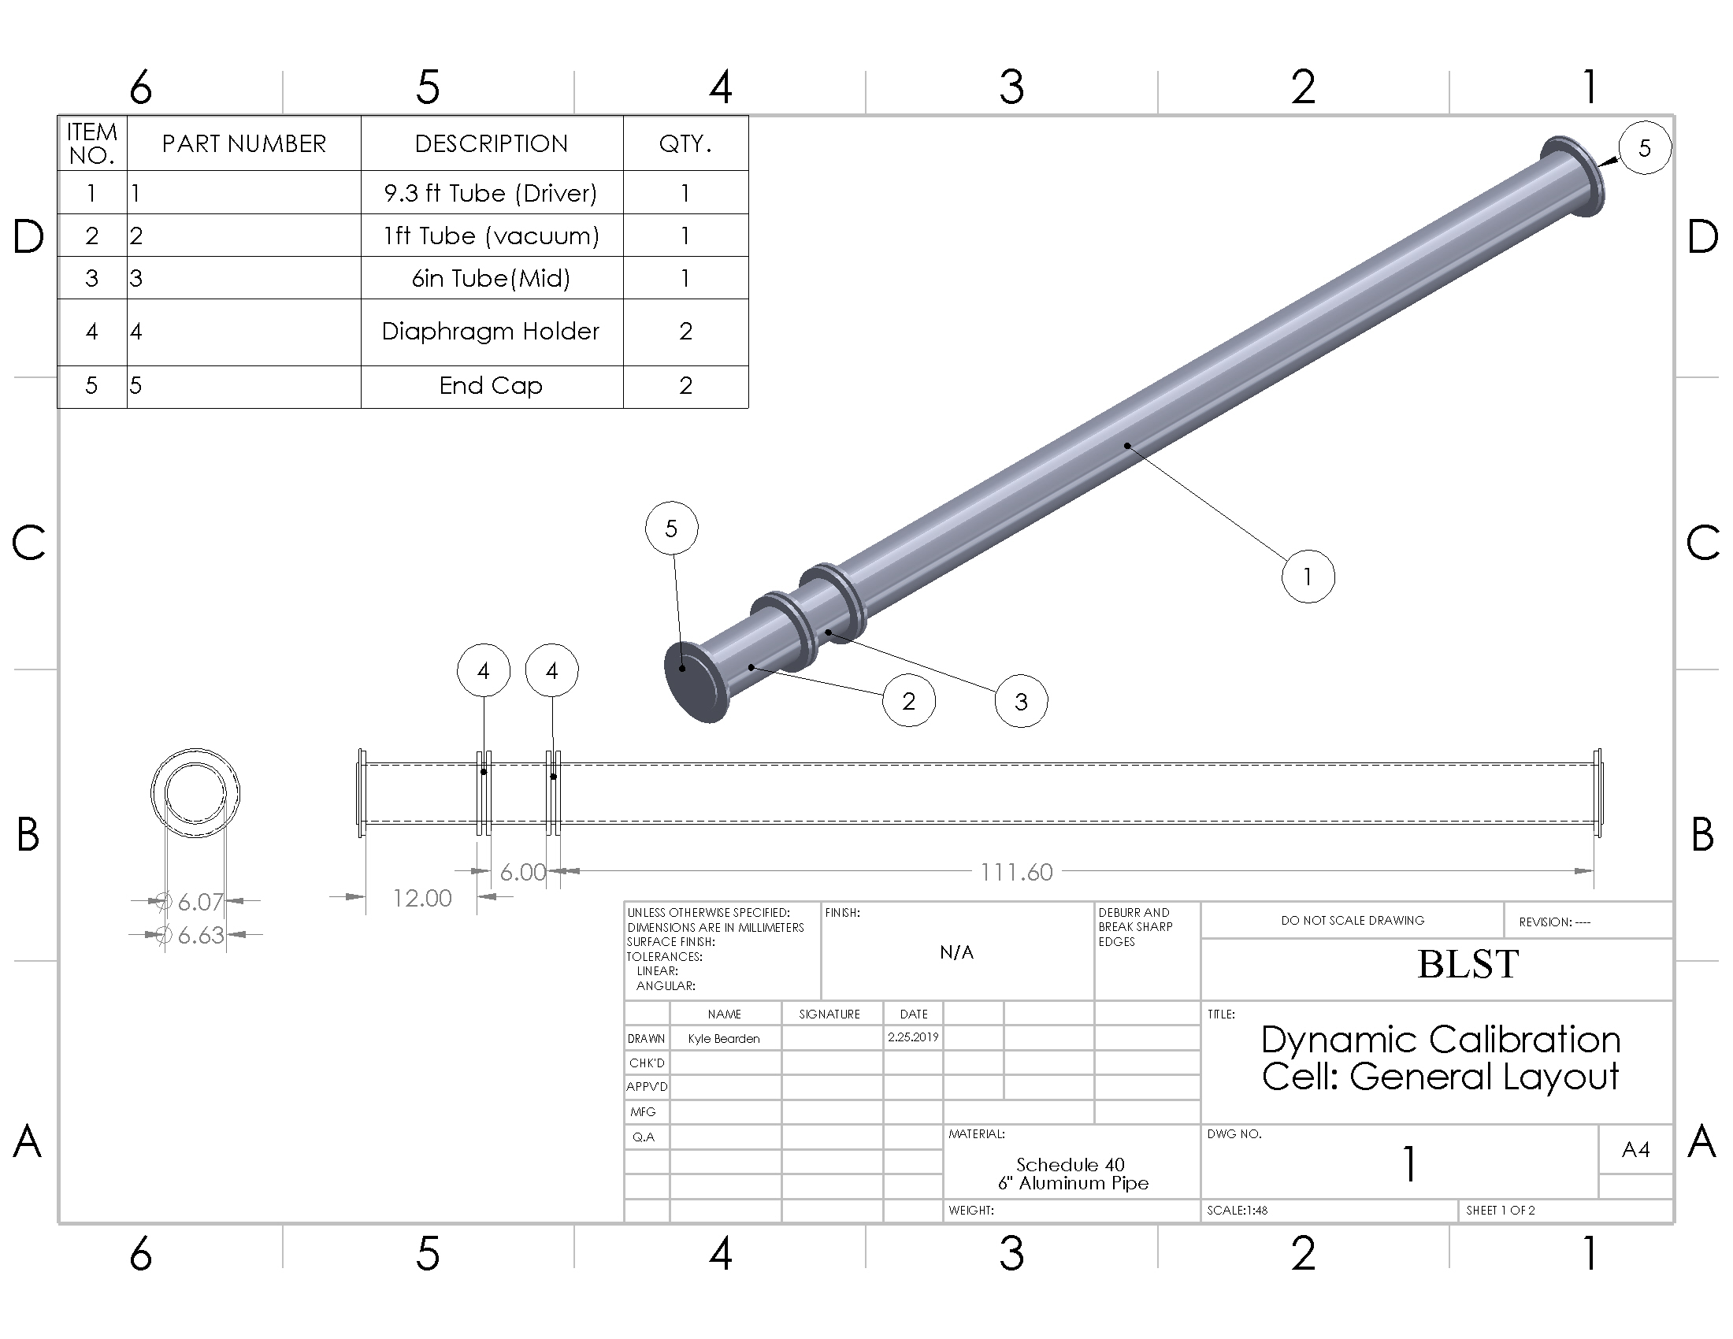
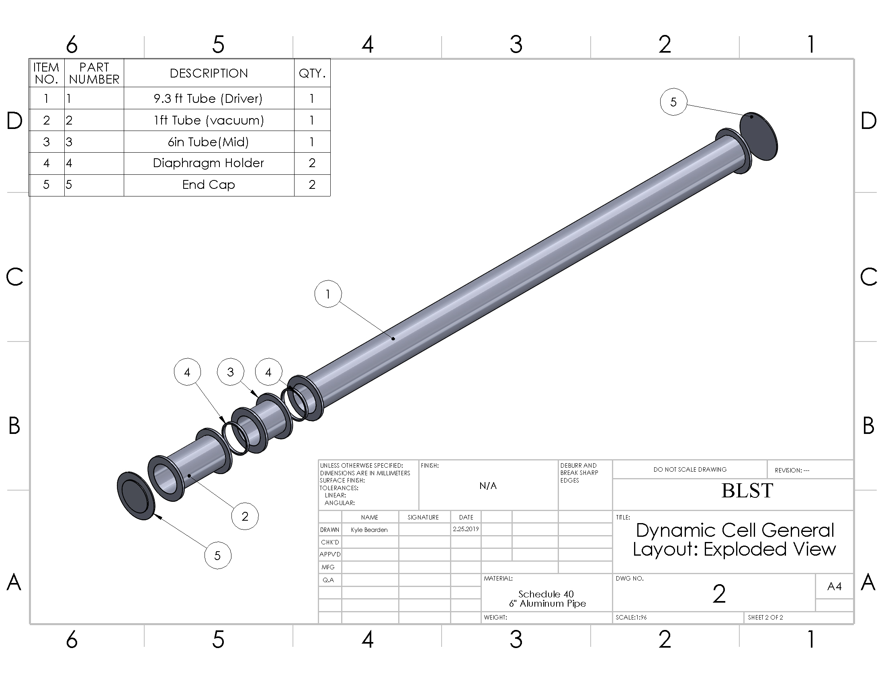
General Layout of Dynamic Cell (Shock-Tube)

Slide 12
Thank you

